Slide 1


Kammavari Sangham (R) 1952, K.S.Group of Institutions
K. S SCHOOL OF ENGINEERING AND MANAGEMENT, BENGALURU-560109
(Affiliated to VTU, Belagavi & Approved by AICTE, New Delhi, Accredited by NAAC)
DEPARTMENT OF ARTIFICIAL INTELLIGENCE & DATA SCIENCE
PROJECT WORK (BAD786)
“AI Powered Traffic Signal Processing”
Under the guidance of:
Mrs. P S Geetha
Assistant Professor
Dept., of AI & DS, KSSEM
Presented by:
Harshitha V 1KG22AD020
M Joshna 1KG22AD034
Mokshitha S Thota 1KG22AD039
R Alekhya 1KG22AD045

Slide 2
AGENDA
Introduction
Problem Statement
Objectives
Methodology of Objectives
Results & Discussion
Conclusion
Slide no: 01

Slide 3
Introduction
Managing traffic in cities is becoming more difficult as the number of vehicles continues to increase. Traditional traffic signals use fixed timings and cannot adjust when traffic becomes heavy. This leads to long delays, traffic jams, more fuel usage, and higher pollution. Because of this, smarter and more adaptive traffic control methods are needed. With the growth of artificial intelligence (AI) and computer vision, traffic signals can now be improved using intelligent techniques. Many AI-based methods exist, but they often have limitations or are not easily scalable. In this work, we propose an AI-based Traffic Signal Processing (TSP) system that adjusts signal timings based on traffic density. The system uses deep learning to detect and count vehicles from simulated traffic videos. An adaptive algorithm then changes the green light duration according to the congestion level. The system is tested using SUMO (Simulation of Urban Mobility) to study its performance under different traffic conditions.
Slide no: 03

Slide 4
Problem Statement
Traditional traffic signal systems are ill-equipped to handle the dynamic and unpredictable nature of modern urban traffic. Most systems still rely on fixed signal timings or manually controlled operations, which leads to unnecessary delays, inefficient vehicle throughput, increased fuel consumption, and environmental degradation. Although various AI-based approaches have been proposed in recent literature, gaps remain in real world deployment, cost-effective scalability, integration of multiple AI techniques under variable traffic conditions.

Slide 5
Objectives
Objective 1:
Dataset Collection & Annotation: Collect, annotate and structure traffic videos for vehicle detection and tracking.
Objective 2:
Model Training for Detection: Train and validate deep learning models to accurately detect and track vehicles in traffic scenes.
Objective 3:
Adaptive Signal Switching: Implement an intelligent traffic signal control algorithm that adapts to vehicle density.
Objective 4:
System Simulation & Evaluation: Simulate traffic scenarios and evaluate system performance using SUMO.
Slide no: 03

Slide 6
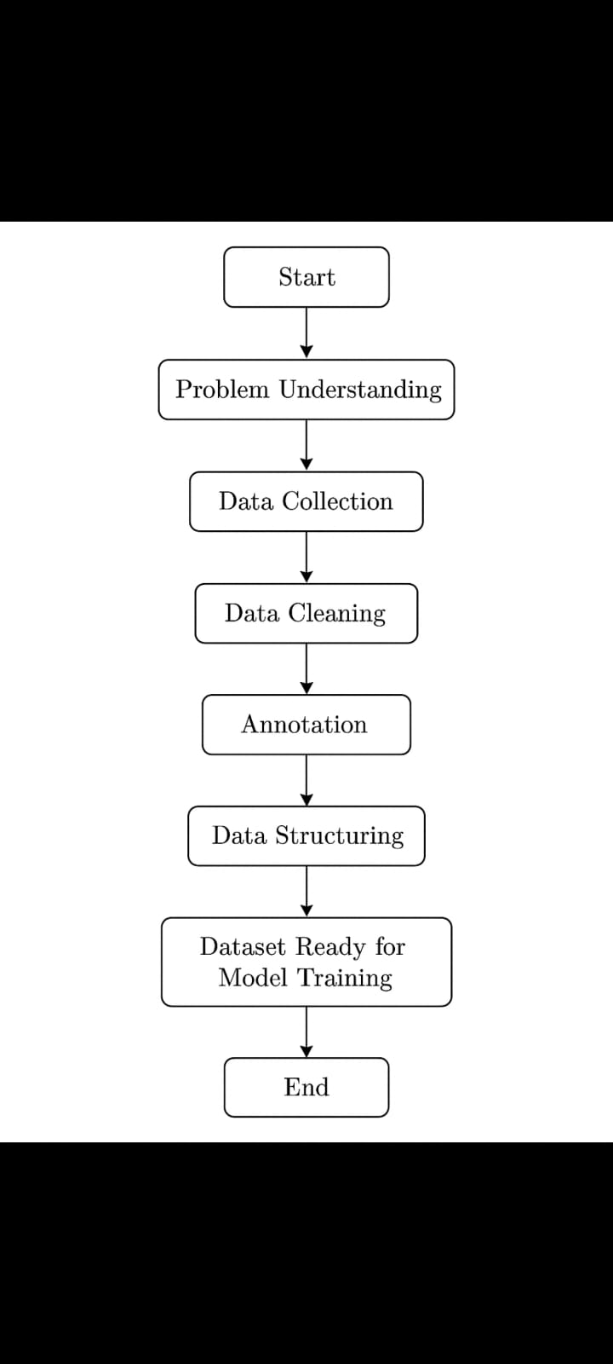
METHODOLOGY
Objective:01
Problem Understanding: Identify the project goals, requirements, and expected outcomes.
Data Collection: Gather relevant raw data from appropriate sources.
Data Cleaning: Remove errors, noise, and inconsistencies from the collected data.
Annotation: Label the cleaned data with accurate tags required for the model.
Data Structuring: Organize the annotated data into a proper format for training.
Dataset Ready for Model Training: Finalize and validate the dataset for seamless model training.

Slide 7
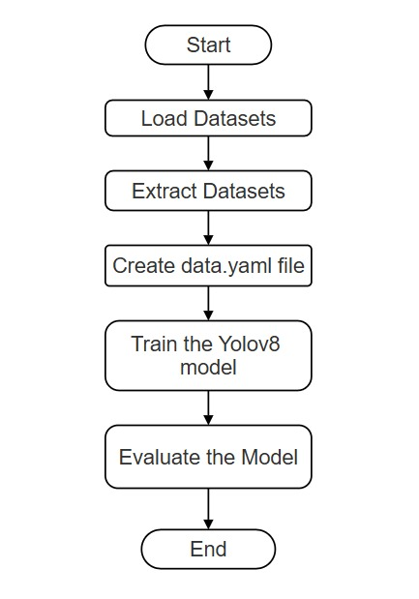
METHODOLOGY
Objective:02
Load and preprocess the dataset containing annotated vehicle images.
Create the data.yaml file specifying paths and the single class vehicle.
Train the YOLOv8 model using the prepared dataset.
Evaluate the model performance.

Slide 8
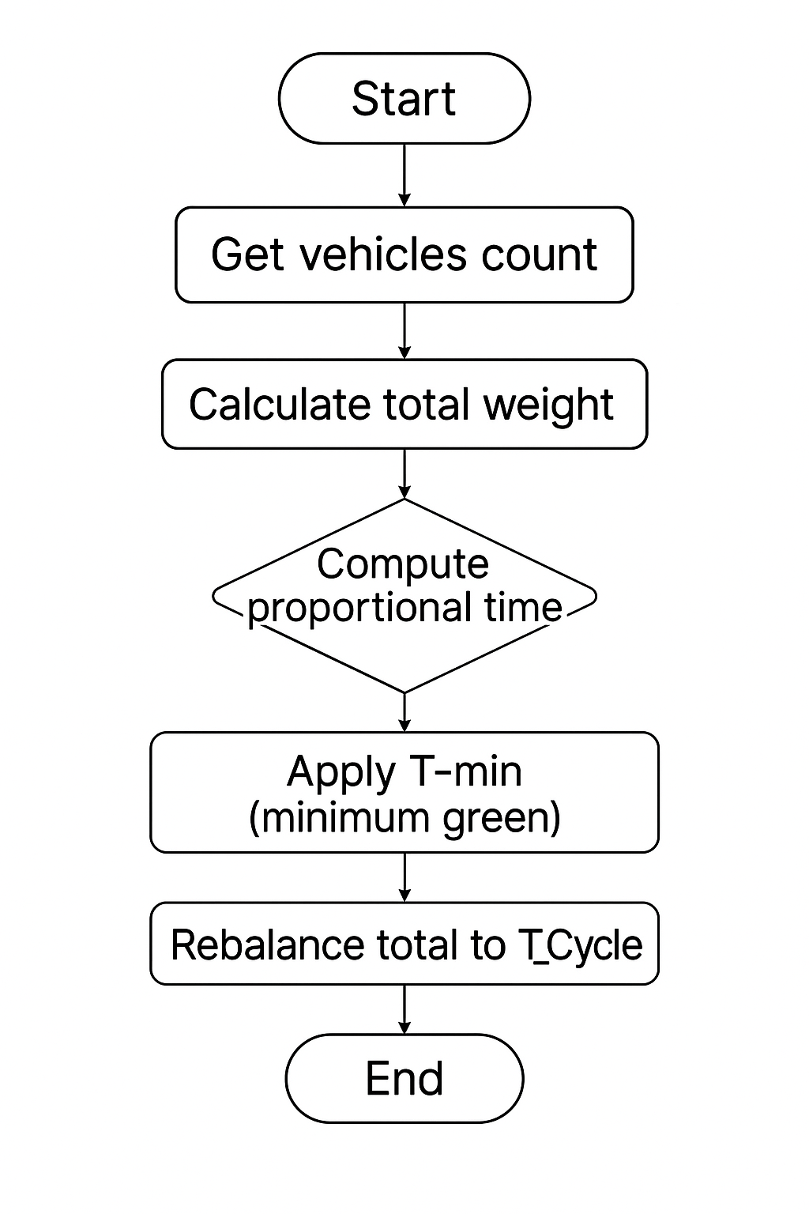
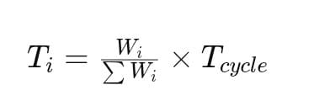
METHODOLOGY
Objective:03
Read Input Data – Vehicle counts for each lane are obtained from sensors or a simulated dataset.
Compute Total Weight – Sum all the vehicle counts.
Allocate Proportional Time –
Each lane gets green time proportional to its traffic weight.
Apply Minimum Time to each lane.
Rebalance Cycle – Adjust the total so that all green times fit within the cycle.
Determine Priority – Lanes are prioritized based on vehicle count (highest first).
Output – Green times and priority order are returned to the signal controller.

Slide 9
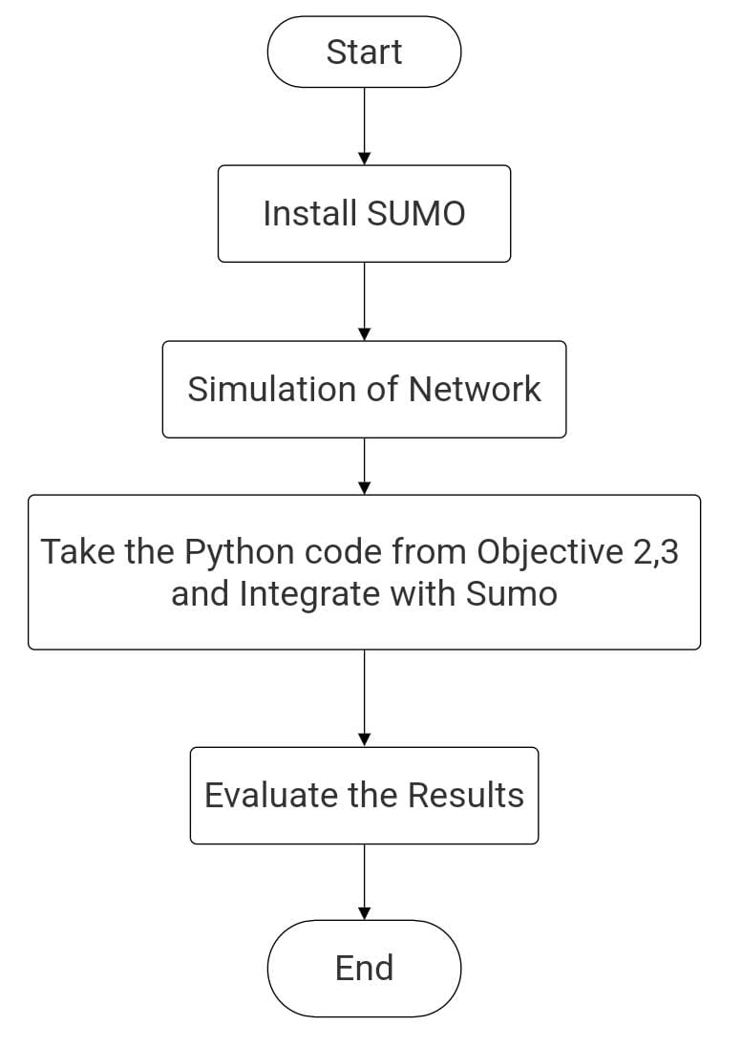
METHODOLOGY
Objective:04
Install SUMO : Installed SUMO and set up the environment to design and simulate the traffic intersection.
Simulation of Network : Built the 4-way intersection, added routes, and ran the traffic simulation in SUMO.
Integrate Python Code : Connected SUMO with Python using TraCI to apply adaptive traffic signal logic.
Evaluate the Results : Compared Baseline vs Adaptive AI performance using queues, green time, and dashboard graphs.

Slide 10
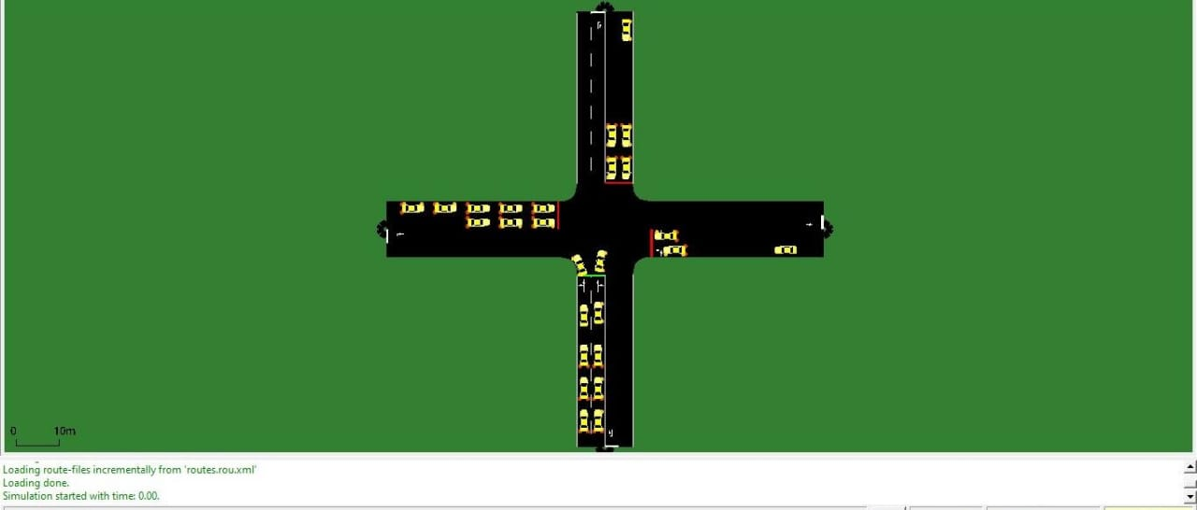
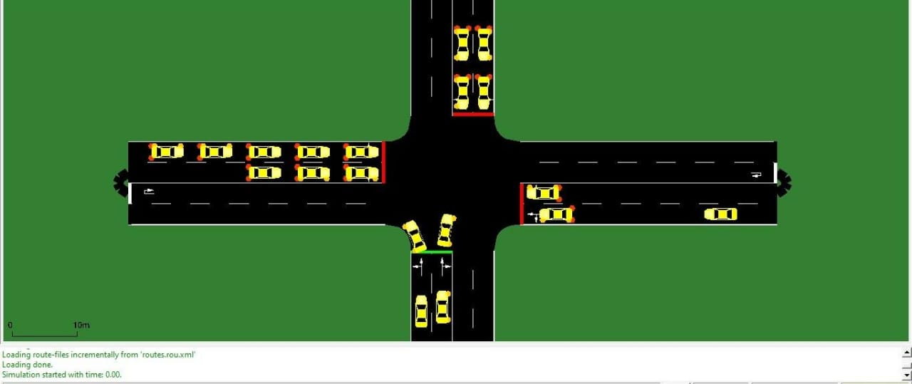
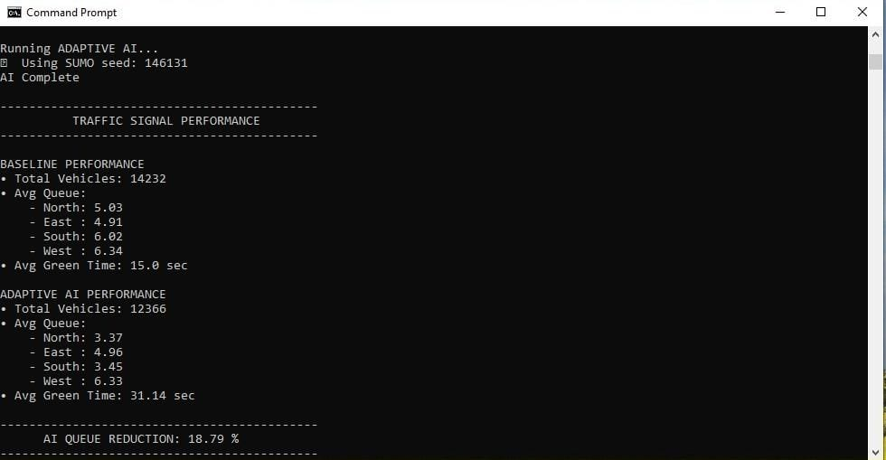
RESULTS AND DISCUSSIONS

Slide 11
CONCLUSION
In this project, we addressed the limitations of traditional fixed-time traffic signals by developing an AI-based adaptive Traffic Signal Processing system capable of responding to real-time traffic conditions. Guided by the objectives of accurate vehicle detection, dynamic signal switching, and system evaluation, we collected and annotated traffic data, trained a YOLO model for reliable vehicle counting, and designed an adaptive algorithm that allocates proportional green time, applies minimum thresholds, and rebalances the total cycle. Using SUMO and TraCI, the methodology was executed end-to-end—building the network, integrating the algorithm, and evaluating performance. The results show that the proposed system reduces congestion, improves traffic flow, and outperforms conventional signal control, fulfilling the goals outlined in the introduction, problem statement, and abstract while proving the effectiveness of the approach for future smart traffic management.

Slide 12
THANK YOU
Slide no: 07

